Slide 1
Chapter 3 | Water

Slide 2
Ch. 3 | Water
3
Key Message #1
Changes in Water Quantity and Quality
Significant changes in water quantity and quality are evident across the country. These changes, which are expected to persist, present an ongoing risk to coupled human and natural systems and related ecosystem services. Variable precipitation and rising temperature are intensifying droughts, increasing heavy downpours, and reducing snowpack. Reduced snow-to-rain ratios are leading to significant differences between the timing of water supply and demand. Groundwater depletion is exacerbating drought risk. Surface water quality is declining as water temperature increases and more frequent high-intensity rainfall events mobilize pollutants such as sediments and nutrients.

Slide 3
Ch. 3 | Water
3
Key Message #2
Deteriorating Water Infrastructure at Risk
Deteriorating water infrastructure compounds the climate risk faced by society. Extreme precipitation events are projected to increase in a warming climate and may lead to more severe floods and greater risk of infrastructure failure in some regions. Infrastructure design, operation, financing principles, and regulatory standards typically do not account for a changing climate. Current risk management does not typically consider the impact of compound extremes (co-occurrence of multiple events) and the risk of cascading infrastructure failure.

Slide 4
Ch. 3 | Water
3
Key Message #3
Water Management in a Changing Future
Water management strategies designed in view of an evolving future we can only partially anticipate will help prepare the Nation for water- and climate-related risks of the future. Current water management and planning principles typically do not address risk that changes over time, leaving society exposed to more risk than anticipated. While there are examples of promising approaches to manage climate risk, the gap between research and implementation, especially in view of regulatory and institutional constraints, remains a challenge.

Slide 5
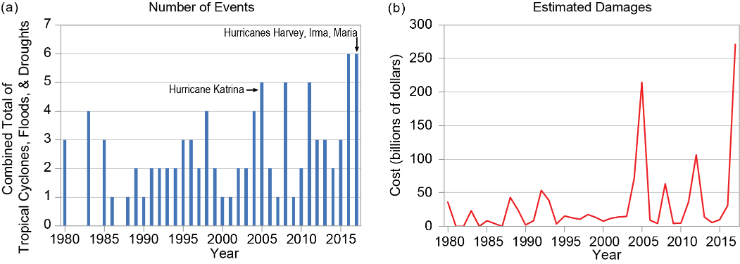
Fig. 3.1: Billion-Dollar Weather and Climate Disaster Events in the United States
Ch. 3 | Water
The figure shows (a) the total number of water-related billion-dollar disaster events (tropical cyclones, flooding, and droughts combined) each year in the United States and (b) the associated costs (in 2017 dollars, adjusted for inflation). Source: adapted from NOAA NCEI 2018.¹⁹
Notes:
19: NOAA NCEI, 2018: Billion-Dollar Weather and Climate Disasters [web page]. NOAA National Centers for Environmental Information, Asheville, NC. https://www.ncdc.noaa.gov/billions/events/US/1980-2017

Slide 6
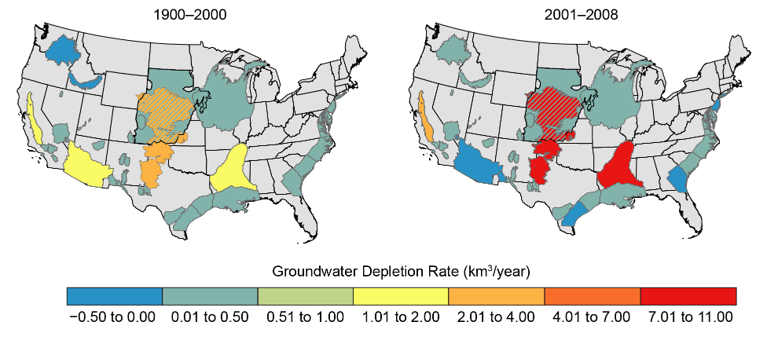
Fig. 3.2: Depletion of Groundwater in Major U.S. Regional Aquifers
Ch. 3 | Water
(left) Groundwater supplies have been decreasing in the major regional aquifers of the United States over the last century (1900–2000). (right) This decline has accelerated recently (2001–2008) due to persistent droughts in many regions and the lack of adequate surface water storage to meet demands. This decline in groundwater compromises the ability to meet water needs during future droughts and impacts the functioning of groundwater dependent ecosystems (e.g., Kløve et al. 2014³). The values shown are net volumetric rates of groundwater depletion (km³ per year) averaged over each aquifer. Subareas of an aquifer may deplete at faster rates or may be actually recovering. Hatching in the figure represents where the High Plains Aquifer overlies the deep, confined Dakota Aquifer. Source: adapted from Konikow 2015.⁴ Reprinted from Groundwater with permission of the National Groundwater Association. ©2015.
Notes:
3: Kløve, B., P. Ala-Aho, G. Bertrand, J.J. Gurdak, H. Kupfersberger, J. Kværner, T. Muotka, H. Mykrä, E. Preda, P. Rossi, C.B. Uvo, E. Velasco, and M. Pulido-Velazquez, 2014: Climate change impacts on groundwater and dependent ecosystems. Journal of Hydrology, 518 (Part B), 250-266. http://dx.doi.org/10.1016/j.jhydrol.2013.06.037
4: Konikow, L.F., 2015: Long‐term groundwater depletion in the United States. Groundwater,53(1), 2-9. http://dx.doi.org/10.1111/gwat.12306

Slide 7
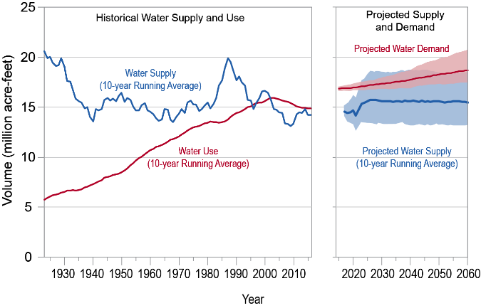
Fig. 3.3: Colorado River Basin Supply and Use
Ch. 3 | Water
The figure shows the Colorado River Basin historical water supply and use, along with projected water supply and demand. The figure illustrates a challenge faced by water managers in many U.S. locations—a potential imbalance between future supply and demand but with considerable long-term variability that is not well understood for the future. For the projections, the dark lines are the median values and the shading represents the 10th to 90th percentile range. Source: adapted from U.S. Bureau of Reclamation 2012.¹¹⁴
Notes:
114: U.S. Bureau of Reclamation, 2012: Colorado River Basin Water Supply and Demand Study. Study report. December 2012. Prepared by the Colorado River Basin Water Supply and Demand Study Team. U.S. Department of the Interior, Bureau of Reclamation, Denver, CO, 95 pp. http://www.usbr.gov/lc/region/programs/crbstudy/finalreport/studyrpt.html

Slide 8
Ch. 3 | Water
3
Chapter Author Team
Federal Coordinating Lead Authors
Thomas Johnson, U.S. Environmental Protection Agency
Peter Colohan, National Oceanic and Atmospheric Administration
Chapter Lead
Upmanu Lall, Columbia University
Chapter Authors
Amir AghaKouchak, University of California, Irvine
Sankar Arumugam, North Carolina State University
Casey Brown, University of Massachusetts
Gregory McCabe, U.S. Geological Survey
Roger Pulwarty, National Oceanic and Atmospheric Administration
Review Editor
Minxue He, California Department of Water Resources

Slide 9
Ch. 3 | Water
3
Acknowledgments
USGCRP Coordinators
Kristin Lewis, Senior Scientist
Allyza Lustig, Program Coordinator

Slide 10
Lall, U., T. Johnson, P. Colohan, A. Aghakouchak, C. Brown, G. McCabe, R. Pulwarty, and A. Sankarasubramanian, 2018: Water. In Impacts, Risks, and Adaptation in the United States: Fourth National Climate Assessment, Volume II [Reidmiller, D.R., C.W. Avery, D.R. Easterling, K.E. Kunkel, K.L.M. Lewis, T.K. Maycock, and B.C. Stewart (eds.)]. U.S. Global Change Research Program, Washington, DC, USA. doi: 10.7930/NCA4.2018.CH3
https://nca2018.globalchange.gov/chapter/water

