Slide 1
Chapter 17 | Sector Interactions, Multiple Stressors, and Complex Systems

Slide 2
Ch. 17 | Sector Interactions, Multiple Stressors, and Complex Systems
17
Key Message #1
Interactions Among Sectors
The sectors and systems exposed to climate (for example, energy, water, and agriculture) interact with and depend on one another and other systems less directly exposed to climate (such as the financial sector). In addition, these interacting systems are not only exposed to climate-related stressors such as floods, droughts, and heat waves, they are also subject to a range of non-climate factors, from population movements to economic fluctuations to urban expansion. These interactions can lead to complex behaviors and outcomes that are difficult to predict. It is not possible to fully understand the implications of climate change on the United States without considering the interactions among sectors and their consequences.

Slide 3
Ch. 17 | Sector Interactions, Multiple Stressors, and Complex Systems
17
Key Message #2
Multisector Risk Assessment
Climate change risk assessment benefits from a multisector perspective, encompassing interactions among sectors and both climate and non-climate stressors. Because such interactions and their consequences can be challenging to identify in advance, effectively assessing multisector risks requires tools and approaches that integrate diverse evidence and that consider a wide range of possible outcomes.

Slide 4
Ch. 17 | Sector Interactions, Multiple Stressors, and Complex Systems
17
Key Message #3
Management of Interacting Systems
The joint management of interacting systems can enhance the resilience of communities, industries, and ecosystems to climate-related stressors. For example, during drought events, river operations can be managed to balance water demand for drinking water, navigation, and electricity production. Such integrated approaches can help avoid missed opportunities or unanticipated tradeoffs associated with the implementation of management responses to climate-related stressors.

Slide 5
Ch. 17 | Sector Interactions, Multiple Stressors, and Complex Systems
17
Key Message #4
Advancing Knowledge
Predicting the responses of complex, interdependent systems will depend on developing meaningful models of multiple, diverse systems, including human systems, and methods for characterizing uncertainty.

Slide 6
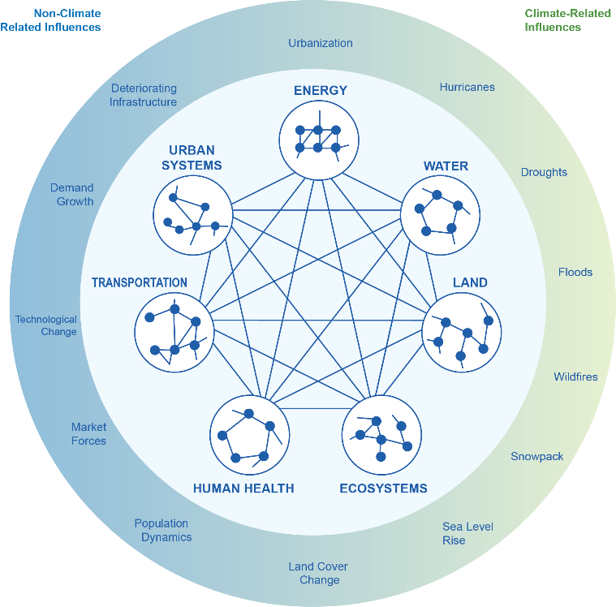
Fig. 17.1: Complex Sectoral Interactions
Ch. 17 | Sector Interactions, Multiple Stressors, and Complex Systems
Sectors are interacting and interdependent through physical, social, institutional, environmental, and economic linkages. These sectors and the interactions among them are affected by a range of climate-related and non-climate influences. Sources: Pacific Northwest National Laboratory, Arizona State University, and Cornell University.

Slide 7
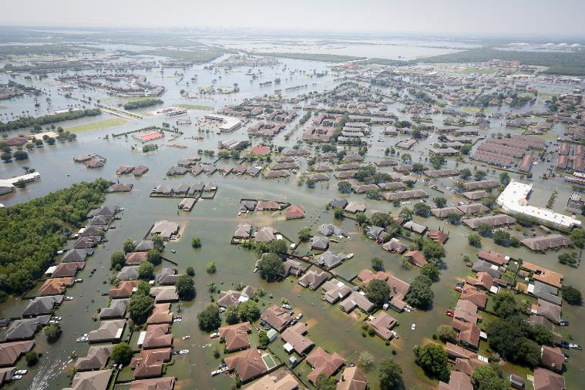
Fig. 17.2: Hurricane Harvey Flooding
Ch. 17 | Sector Interactions, Multiple Stressors, and Complex Systems
Hurricane Harvey led to widespread flooding and knocked out power to 300,000 customers in Texas in 2017, with cascading effects on critical infrastructure facilities such as hospitals, water and wastewater treatment plants, and refineries. The photo shows Port Arthur, Texas, on August 31, 2017—six days after Hurricane Harvey made landfall along the Gulf Coast. Photo credit: Staff Sgt. Daniel J. Martinez, U.S. Air National Guard.

Slide 8
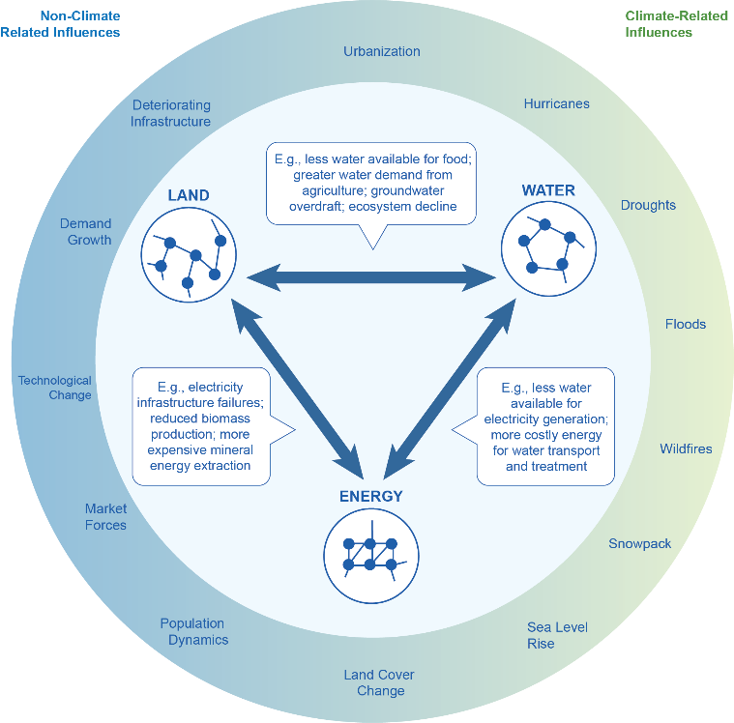
Fig. 17.3: Energy–
Water–Land Interactions
Ch. 17 | Sector Interactions, Multiple Stressors, and Complex Systems
Energy, water, and land systems are interconnected and impacted by both climate-related and non-climate stressors. These influences affect these systems individually as well as the dynamics among these sectors. A multisector perspective is necessary to understand risks and develop response strategies that enhance resilience across multiple systems. Sources: Pacific Northwest National Laboratory, Arizona State University, and Cornell University.

Slide 9
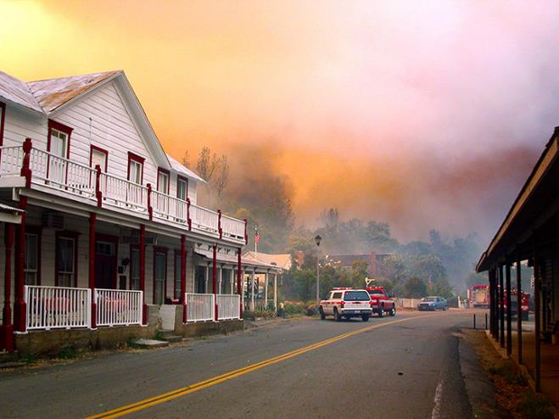
Fig. 17.4: Wildfire at the Wildland–Urban Interface
Ch. 17 | Sector Interactions, Multiple Stressors, and Complex Systems
Wildfires pose significant health and economic impacts through interfaces between wildlands and human settlements. Shown here is a wildfire in the Whiskeytown National Recreation Area in California in August 2004. Photo credit: Carol Jandrall, National Park Service.

Slide 10
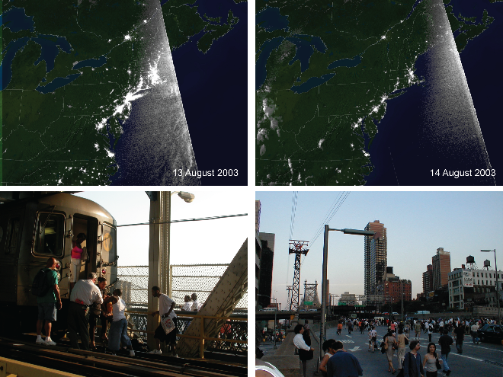
Fig. 17.5: Northeast Blackout
Ch. 17 | Sector Interactions, Multiple Stressors, and Complex Systems
During the August 2003 blackout, an estimated 50 million people in Canada and the northeastern United States lost power, with cascading impacts on public health and critical infrastructure. These images show (clockwise from upper left): nighttime satellite imagery of the area before the outage; the same view during the blackout; people walking on the Manhattan Bridge; and passengers being evacuated from a subway train on the Manhattan Bridge during the outage. Image credits: (top) NOAA; (bottom left) Jack Szwergold (CC BY-NC 2.0); (bottom right) Eric Skiff (CC BY-SA 2.0).

Slide 11
Ch. 17 | Sector Interactions, Multiple Stressors, and Complex Systems
17
Chapter Author Team
Federal Coordinating Lead Authors
Leah Nichols, National Science Foundation
Robert Vallario, U.S. Department of Energy
Chapter Lead
Leon Clarke, Pacific Northwest National Laboratory
Chapter Authors
Mohamad Hejazi, Pacific Northwest National Laboratory
Jill Horing, Pacific Northwest National Laboratory
Anthony C. Janetos, Boston University
Katharine Mach, Stanford University
Michael Mastrandrea, Carnegie Institute for Science
Marilee Orr, U.S. Department of Homeland Security
Benjamin L. Preston, Rand Corporation
Patrick Reed, Cornell University
Ronald D. Sands, U.S. Department of Agriculture
Dave D. White, Arizona State University
Review Editor
Kai Lee, Williams College (Emeritus) and the Packard Foundation (Retired)

Slide 12
Ch. 17 | Sector Interactions, Multiple Stressors, and Complex Systems
17
Acknowledgments
USGCRP Coordinators
Kristin Lewis, Senior Scientist
Natalie Bennett, Adaptation and Assessment Analyst

Slide 13
Clarke, L., L. Nichols, R. Vallario, M. Hejazi, J. Horing, A.C. Janetos, K. Mach, M. Mastrandrea, M. Orr, B.L. Preston, P. Reed, R.D. Sands, and D.D. White, 2018: Sector Interactions, Multiple Stressors, and Complex Systems. In Impacts, Risks, and Adaptation in the United States: Fourth National Climate Assessment, Volume II [Reidmiller, D.R., C.W. Avery, D.R. Easterling, K.E. Kunkel, K.L.M. Lewis, T.K. Maycock, and B.C. Stewart (eds.)]. U.S. Global Change Research Program, Washington, DC, USA. doi: 10.7930/NCA4.2018.CH17
https://nca2018.globalchange.gov/chapter/complex-systems

