Slide 1
Chapter 26 | Alaska

Slide 2
Ch. 26 | Alaska
26
Key Message #1
Marine Ecosystems
Alaska’s marine fish and wildlife habitats, species distributions, and food webs, all of which are important to Alaska’s residents, are increasingly affected by retreating and thinning arctic summer sea ice, increasing temperatures, and ocean acidification. Continued warming will accelerate related ecosystem alterations in ways that are difficult to predict, making adaptation more challenging.

Slide 3
Ch. 26 | Alaska
26
Key Message #2
Terrestrial Processes
Alaska residents, communities, and their infrastructure continue to be affected by permafrost thaw, coastal and river erosion, increasing wildfire, and glacier melt. These changes are expected to continue into the future with increasing temperatures, which would directly impact how and where many Alaskans will live.

Slide 4
Ch. 26 | Alaska
26
Key Message #3
Human Health
A warming climate brings a wide range of human health threats to Alaskans, including increased injuries, smoke inhalation, damage to vital water and sanitation systems, decreased food and water security, and new infectious diseases. The threats are greatest for rural residents, especially those who face increased risk of storm damage and flooding, loss of vital food sources, disrupted traditional practices, or relocation. Implementing adaptation strategies would reduce the physical, social, and psychological harm likely to occur under a warming climate.

Slide 5
Ch. 26 | Alaska
26
Key Message #4
Indigenous Peoples
The subsistence activities, culture, health, and infrastructure of Alaska’s Indigenous peoples and communities are subject to a variety of impacts, many of which are expected to increase in the future. Flexible, community-driven adaptation strategies would lessen these impacts by ensuring that climate risks are considered in the full context of the existing sociocultural systems.

Slide 6
Ch. 26 | Alaska
26
Key Message #5
Economic Costs
Climate warming is causing damage to infrastructure that will be costly to repair or replace, especially in remote Alaska. It is also reducing heating costs throughout the state. These effects are very likely to grow with continued warming. Timely repair and maintenance of infrastructure can reduce the damages and avoid some of these added costs.

Slide 7
Ch. 26 | Alaska
26
Key Message #6
Adaptation
Proactive adaptation in Alaska would reduce both short- and long-term costs associated with climate change, generate social and economic opportunity, and improve livelihood security. Direct engagement and partnership with communities is a vital element of adaptation in Alaska.

Slide 8
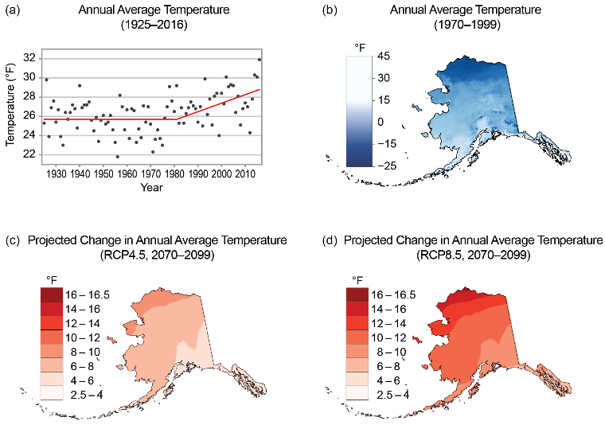
Fig. 26.1: Observed and Projected Changes in Annual Average Temperature
Ch. 26 | Alaska
(a) The graph shows Alaska statewide annual average temperatures for 1925–2016. The record shows no clear change from 1925 to 1976 due to high variability, but from 1976–2016 a clear trend of +0.7°F per decade is evident. (b) The map shows 1970–1999 annual average temperature. Alaska has a diverse climate, much warmer in the southeast and southwest than on the North Slope. (c) The map shows projected changes from climate models in annual average temperature for end of the 21st century under a lower scenario (RCP4.5). (d) The map is the same as (c) but for a higher scenario (RCP8.5). Sources: (a) National Weather Service and U.S. Geological Survey, (b–d) U.S. Geological Survey.

Slide 9
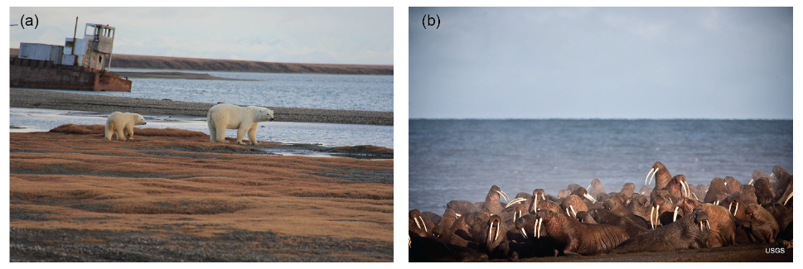
Fig. 26.2: Polar Bears and Walruses
Ch. 26 | Alaska
(a) An adult female polar bear and cub are shown near Kaktovik, Alaska, in September 2015. (b) Walruses gathered on the shores of the Chukchi Sea near Point Lay, Alaska, in September 2013. Photo credits: (a) Stewart Breck, USDA (b) Ryan Kingsbery, USGS.

Slide 10
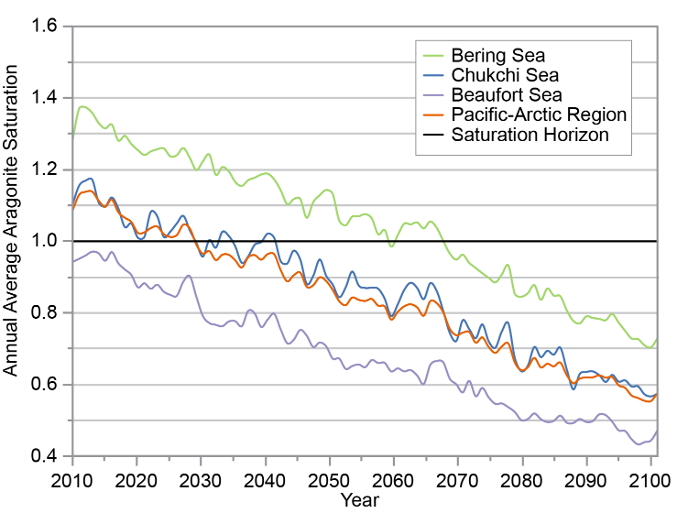
Fig. 26.3: Projected Changes in Arctic Ocean Acidity
Ch. 26 | Alaska
The time series shows the projected decline in the annual average aragonite saturation (one of the consequences of increased ocean acidity, or lower pH) for the Bering Sea, Chukchi Sea, Beaufort Sea, and for the entire Pacific-Arctic region under the higher scenario (RCP8.5). Aragonite saturation is a metric used to assess ocean acidification and the ability for organisms to build shells and skeletons. The annual average saturation state for the Beaufort Sea surface waters likely crossed the saturation horizon—a tipping point—around 2001, meaning it is currently undersaturated and its marine ecosystems are vulnerable to the impacts of ocean acidification during most of the year. The Chukchi Sea is projected to first cross this threshold around 2030 and then likely remain under the threshold after the early 2040s; the Bering Sea is projected to be a concern after 2065. Source: adapted from Mathis et al. 2015.¹⁸
Notes:
18: Mathis, J.T., J.N. Cross, W. Evans, and S.C. Doney, 2015: Ocean acidification in the surface waters of the Pacific–Arctic boundary regions. Oceanography, 28 (2), 122-135. http://dx.doi.org/10.5670/oceanog.2015.36

Slide 11
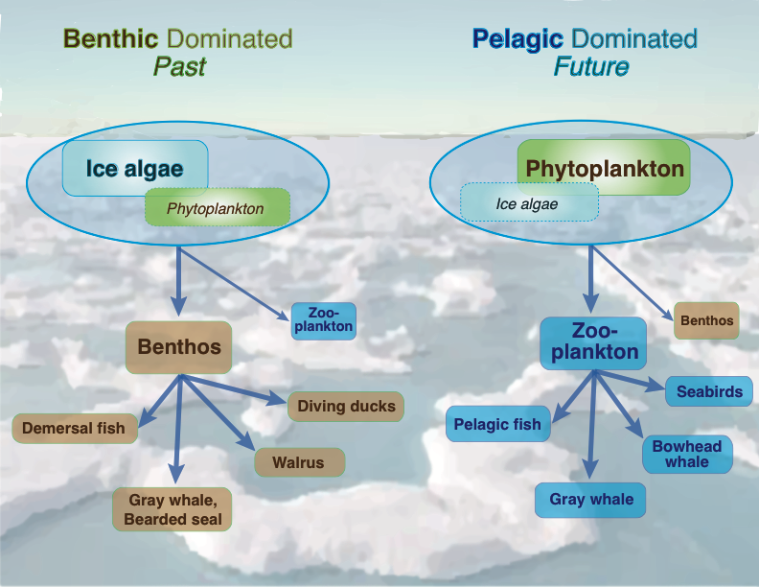
Fig. 26.4: Changes to North Pacific Marine Ecosystems in a Warming Climate
Ch. 26 | Alaska
As sea ice thins and retreats earlier in the season, it is anticipated that food webs under the ice will switch from a benthic-dominated (lower in the water to seafloor) to a pelagic-dominated (middle to higher in the water) marine ecosystem. Source: Moore and Stabeno 2015.⁷⁸
Notes:
78: Moore, S.E. and P.J. Stabeno, 2015: Synthesis of Arctic Research (SOAR) in marine ecosystems of the Pacific Arctic. Progress in Oceanography, 136, 1-11. http://dx.doi.org/10.1016/j.pocean.2015.05.017

Slide 12
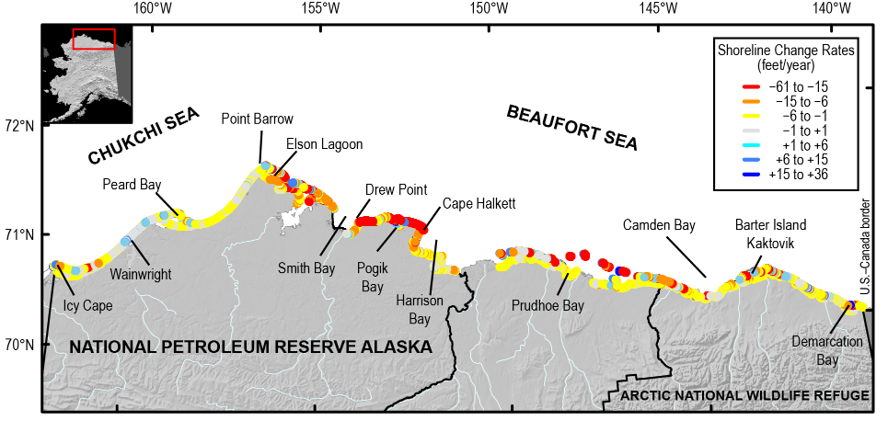
Fig. 26.5: Erosion Rates Along Alaska’s North Coast
Ch. 26 | Alaska
The map is of the north coast of Alaska and shows color-coded shoreline erosion rates, which can lead to the loss of habitat, cultural resources, and infrastructure. Source: adapted from Gibbs and Richmond 2015.¹⁹
Notes:
19: Gibbs, A.E. and B.M. Richmond, 2015: National Assessment of Shoreline Change: Historical Shoreline Change Along the North Coast of Alaska, U.S.–Canadian Border to Icy Cape. U.S. Geological Survey Open-File Report 2015–1048. U.S. Geological Survey, 96 pp. http://dx.doi.org/10.3133/ofr20151048

Slide 13
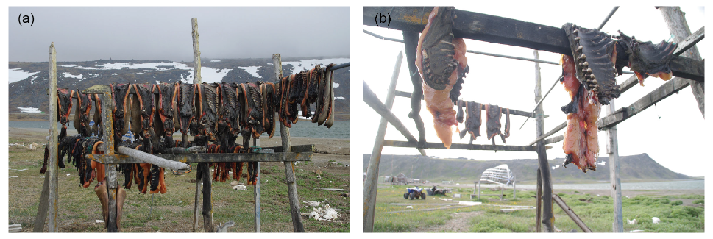
Fig. 26.6: Variable Weather Affects Harvest Levels
Ch. 26 | Alaska
These images of marine mammal meat drying on racks in Gambell, Alaska, in (a) June 2012 and (b) July 2013 illustrate the interannual variability of harvests due to sea ice and weather conditions and suggest what the future may hold if ice and weather trends continue. Photo credit: Henry P. Huntington.

Slide 14
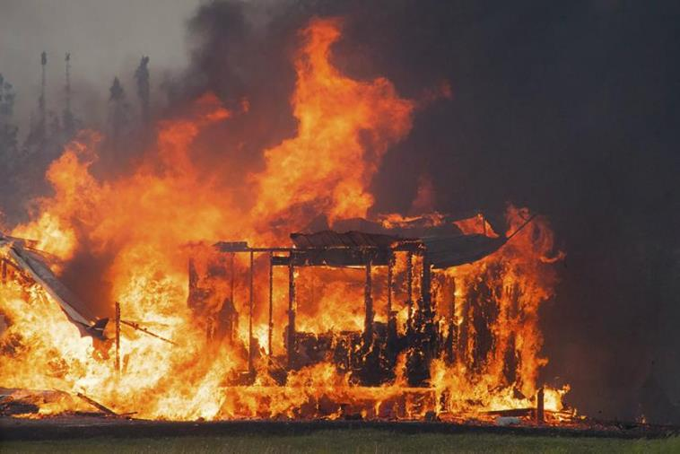
Fig. 26.7: Wildfire Destroys Homes Near Willow, Alaska
Ch. 26 | Alaska
The 7,220-acre Sockeye Fire near Willow, Alaska, totally destroyed 55 residences and damaged 44 in mid-June 2015. Photo courtesy of Matanuska-Susitna Borough/Stefan Hinman.

Slide 15
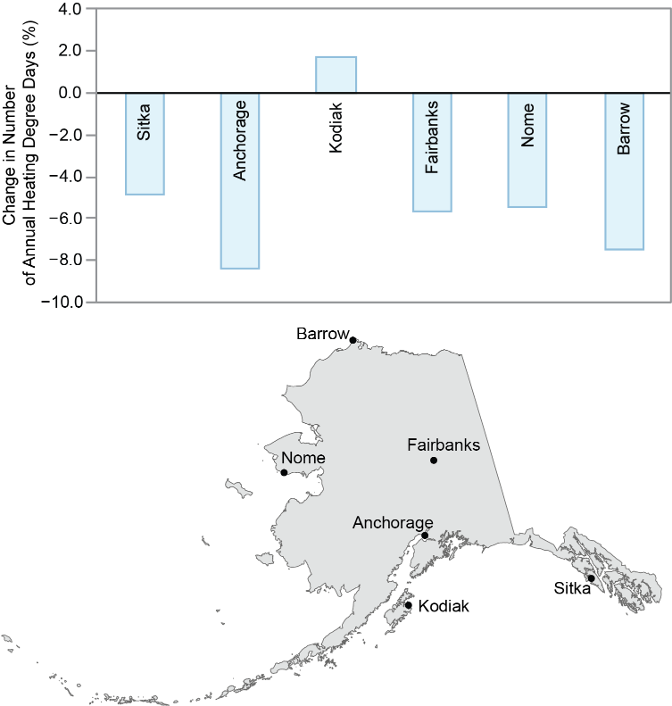
Fig. 26.8: Energy Needed for Heating Decreases Across Much of Alaska
Ch. 26 | Alaska
The chart shows the percentage change in annual heating degree days for the period 2000–2015 (as compared to 1950–1979) for six Alaska communities. Every 1% decline in heating degree days could potentially yield $10 million of annual savings in heating costs. Source: University of Alaska Anchorage, NOAA NCEI, and ERT Inc.

Slide 16
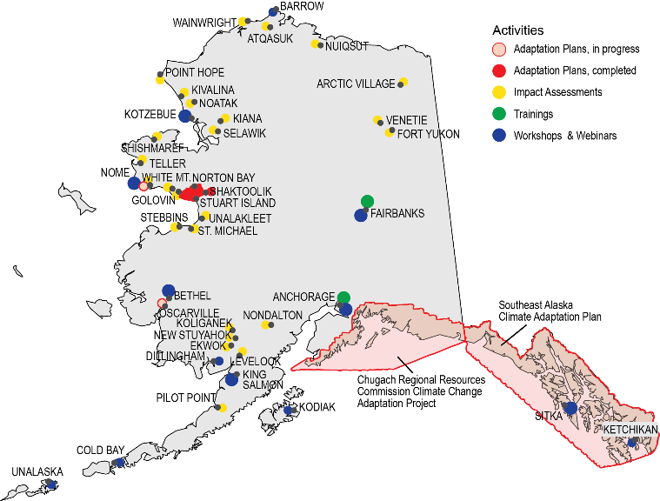
Fig. 26.9: Adaptation Planning in Alaska
Ch. 26 | Alaska
The map shows tribal climate adaptation planning efforts in Alaska. Research is considered to be adaptation under some classification schemes.^{1,2} Alaska is scientifically data poor, compared to other Arctic regions.³ In addition to research conducted at universities and by federal scientists, local community observer programs exist through several organizations, including the National Weather Service for weather and river ice observations;⁴ the University of Alaska for invasive species;⁵ and the Alaska Native Tribal Health Consortium for local observations of environmental change.⁶ Additional examples of community-based monitoring can be found through the website of the Alaska Ocean Observing System.⁷ Source: adapted from Meeker and Kettle 2017.⁸
Notes:
1: SEGCC, 2007: Confronting Climate Change: Avoiding the Unmanageable and Managing the Unavoidable. Report Prepared for the United Nations Commission on Sustainable Development. Bierbaum, R., J.P. Holdren, M. MacCracken, R.H. Moss, P.H. Raven, and H.J. Schellnhuber, Eds. Scientific Expert Group on Climate Change, Sigma Xi and the United Nations Foundation, Research Triangle Park, NC and Washington, DC, 144 pp. http://www.globalproblems-globalsolutions-files.org/unf_website/PDF/climate%20_change_avoid_unmanagable_manage_unavoidable.pdf
2: Tompkins, E.L., W.N. Adger, E. Boyd, S. Nicholson-Cole, K. Weatherhead, and N. Arnell, 2010: Observed adaptation to climate change: UK evidence of transition to a well-adapting society. Global Environmental Change, 20 (4), 627-635. http://dx.doi.org/10.1016/j.gloenvcha.2010.05.001
3: U.S. Arctic Research Commission, 2013: Report on the Goals and Objectives for Arctic Research 2013-2014. U.S. Arctic Research Commission, Arlington, VA and Anchorage, AK, 24 pp. https://storage.googleapis.com/arcticgov-static/publications/goals/usarc_goals_2013-14.pdf
4:NOAA, [2016]: National Weather Service Cooperative Observer Program. https://www.weather.gov/coop/
5: BioMap Alaska, 2012: BioMap Alaska: Citizen science for Alaska's oceans [web site]. Alaska Center for Climate Assessment & Policy, Fairbanks. http://www.biomapalaska.org/
6: ANTHC-LEO, 2017: Local Environmental Observer (LEO) Network. Alaska Native Tribal Health Consortium (ANTHC), Anchorage, AK, accessed August, 2017. http://www.leonetwork.org
7: AOOS, 2017: Harmful Algal Bloom Information System for Kachemak Bay, Alaska. Alaska Ocean Observing System (AOOS), Anchorage, AK, accessed August, 2017. http://www.aoos.org/k-bay-hab/
8: Meeker, D. and N. Kettle, 2017: A Synthesis of Climate Adaptation Planning Needs in Alaska Native Communities. Alaska Center for Climate Assessment and Policy, Fairbanks, 28 pp. https://accap.uaf.edu/Tribal_synthesis

Slide 17
Ch. 26 | Alaska
26
Chapter Author Team
Federal Coordinating Lead Author
Stephen T. Gray, U.S. Geological Survey
Chapter Lead
Carl Markon, U.S. Geological Survey (Retired)
Chapter Authors
Matthew Berman, University of Alaska, Anchorage
Laura Eerkes-Medrano, University of Victoria
Thomas Hennessy, U.S. Centers for Disease Control and Prevention
Henry P. Huntington, Huntington Consulting
Jeremy Littell, U.S. Geological Survey
Molly McCammon, Alaska Ocean Observing System
Richard Thoman, National Oceanic and Atmospheric Administration
Sarah Trainor, University of Alaska Fairbanks
Review Editor
Victoria Herrmann, The Arctic Institute

Slide 18
Ch. 26 | Alaska
26
Acknowledgments
Technical Contributors
Anthony Arendt, University of Washington
Todd Attwood, U.S. Geological Survey
Todd Brinkman, University of Alaska Fairbanks
Patricia Cochran, Alaska Native Science Commission
Jessica N. Cross, National Oceanic and Atmospheric Administration
David Driscoll, University of Virginia
Darcy Dugan, Alaska Ocean Observing System
Tony Fischbach, U.S. Geological Survey
Ann Gibbs, U.S. Geological Survey
Jeff Hetrick, Alutiiq Pride Shellfish Hatchery
David Hill, Oregon State University
Anne Hollowed, National Oceanic and Atmospheric Administration
Eran Hood, University of Alaska Southeast
Torre Jorgenson, Arctic Long Term Ecological Research
Nathan Kettle, University of Alaska Fairbanks
Don Lemmen, Natural Resources Canada

Slide 19
Ch. 26 | Alaska
26
Acknowledgments
Technical Contributors (cont.)
Philip Loring, University of Saskatoon
Jeremy Mathis, National Oceanic and Atmospheric Administration
Franz Mueter, University of Alaska Fairbanks
Shad O’Neel, U.S. Geological Survey
Jacquelyn (Jaci) Overbeck, Alaska Department of Natural Resources
Neal Pastick, U.S. Geological Survey
John Pearce, U.S. Geological Survey
Benjamin Preston, RAND Corporation
Robert Rabin, National Oceanic and Atmospheric Administration
Bruce Richmond, U.S. Geological Survey
Jennifer Schmidt, University of Alaska Anchorage
David K. Swanson, National Park Service
Stefan Tangen, University of Alaska Fairbanks
Lyman Thorsteinson, U.S. Geological Survey
Ryan Toohey, U.S. Geological Survey
USGCRP Coordinators
Fredric Lipschultz, Senior Scientist and Regional Coordinator
Susan Aragon-Long, Senior Scientist

Slide 20
Markon, C., S. Gray, M. Berman, L. Eerkes-Medrano, T. Hennessy, H. Huntington, J. Littell, M. McCammon, R. Thoman, and S. Trainor, 2018: Alaska. In Impacts, Risks, and Adaptation in the United States: Fourth National Climate Assessment, Volume II [Reidmiller, D.R., C.W. Avery, D.R. Easterling, K.E. Kunkel, K.L.M. Lewis, T.K. Maycock, and B.C. Stewart (eds.)]. U.S. Global Change Research Program, Washington, DC, USA. doi: 10.7930/NCA4.2018.CH26
https://nca2018.globalchange.gov/chapter/alaska

