Slide 1
Chapter 28 | Reducing Risks Through Adaptation Actions

Slide 2
Ch. 28 | Reducing Risks Through Adaptation Actions
28
Key Message #1
Adaptation Implementation Is Increasing
Adaptation planning and implementation activities are occurring across the United States in the public, private, and nonprofit sectors. Since the Third National Climate Assessment, implementation has increased but is not yet commonplace.

Slide 3
Ch. 28 | Reducing Risks Through Adaptation Actions
28
Key Message #2
Climate Change Outpaces Adaptation Planning
Successful adaptation has been hindered by the assumption that climate conditions are and will be similar to those in the past. Incorporating information on current and future climate conditions into design guidelines, standards, policies, and practices would reduce risk and adverse impacts.

Slide 4
Ch. 28 | Reducing Risks Through Adaptation Actions
28
Key Message #3
Adaptation Entails Iterative Risk Management
Adaptation entails a continuing risk management process; it does not have an end point. With this approach, individuals and organizations of all types assess risks and vulnerabilities from climate and other drivers of change (such as economic, environmental, and societal), take actions to reduce those risks, and learn over time.

Slide 5
Ch. 28 | Reducing Risks Through Adaptation Actions
28
Key Message #4
Benefits of Proactive Adaptation Exceed Costs
Proactive adaptation initiatives—including changes to policies, business operations, capital investments, and other steps—yield benefits in excess of their costs in the near term, as well as over the long term. Evaluating adaptation strategies involves consideration of equity, justice, cultural heritage, the environment, health, and national security.

Slide 6
Ch. 28 | Reducing Risks Through Adaptation Actions
28
Key Message #5
New Approaches Can Further Reduce Risk
Integrating climate considerations into existing organizational and sectoral policies and practices provides adaptation benefits. Further reduction of the risks from climate change can be achieved by new approaches that create conditions for altering regulatory and policy environments, cultural and community resources, economic and financial systems, technology applications, and ecosystems.

Slide 7
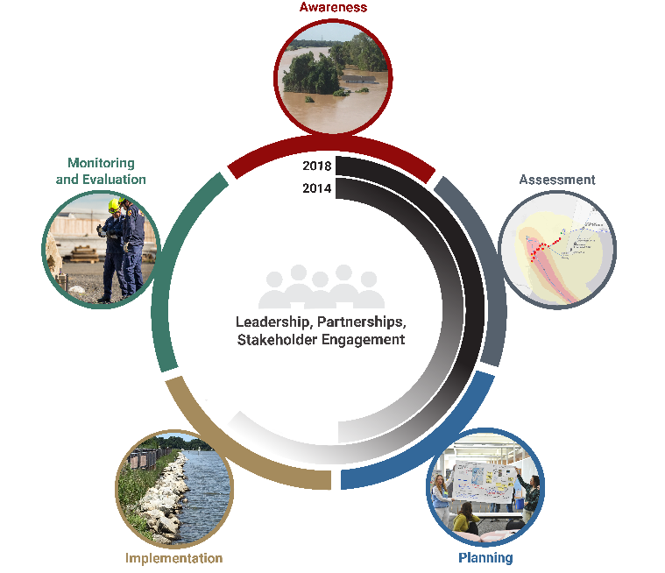
Fig. 28.1: Five Adaptation Stages and Progress
Ch. 28 | Reducing Risks Through Adaptation Actions
The figure illustrates the adaptation iterative risk management process. The gray arced lines compare the current status of implementing this process with the status reported by the Third National Climate Assessment in 2014. Darker color indicates more activity. Source: adapted from National Research Council, 2010.¹ Used with permission from the National Academies Press, ©2010, National Academy of Sciences. Image credits, clockwise from top: National Weather Service; USGS; Armando Rodriguez, Miami-Dade County; Dr. Neil Berg, MARISA; Bill Ingalls, NASA.
Notes:
1: National Research Council, 2010: Adapting to the Impacts of Climate Change. The National Academies Press, Washington, DC, 292 pp. http://dx.doi.org/10.17226/12783

Slide 8
Ch. 28 | Reducing Risks Through Adaptation Actions
28
Chapter Author Team
Federal Coordinating Lead Authors
Jeffrey Arnold, U.S. Army Corps of Engineers
Roger Pulwarty, National Oceanic and Atmospheric Administration
Chapter Lead
Robert Lempert, RAND Corporation
Chapter Authors
Kate Gordon, Paulson Institute
Katherine Greig, Wharton Risk Management and Decision Processes Center at University of Pennsylvania (formerly New York City Mayor’s Office of Recovery and Resiliency)
Cat Hawkins Hoffman, National Park Service
Dale Sands, Village of Deer Park, Illinois
Caitlin Werrell, The Center for Climate and Security
Review Editor
Mary Ann Lazarus, Cameron MacAllister Group

Slide 9
Ch. 28 | Reducing Risks Through Adaptation Actions
28
Acknowledgments
Technical Contributors
Lauren Kendrick, RAND Corporation
Pat Mulroy, Brookings Institution
Costa Samaras, Carnegie Mellon University
Bruce Stein, National Wildlife Federation
Tom Watson, The Center for Climate and Security
Jessica Wentz, Columbia University
USGCRP Coordinators
Sarah Zerbonne, Adaptation and Decision Science Coordinator
Fredric Lipschultz, Senior Scientist and Regional Coordinator

Slide 10
Lempert, R., J. Arnold, R. Pulwarty, K. Gordon, K. Greig, C. Hawkins Hoffman, D. Sands, and C. Werrell, 2018: Reducing Risks Through Adaptation Actions. In Impacts, Risks, and Adaptation in the United States: Fourth National Climate Assessment, Volume II [Reidmiller, D.R., C.W. Avery, D.R. Easterling, K.E. Kunkel, K.L.M. Lewis, T.K. Maycock, and B.C. Stewart (eds.)]. U.S. Global Change Research Program, Washington, DC, USA. doi: 10.7930/NCA4.2018.CH28
https://nca2018.globalchange.gov/chapter/adaptation

